Slide 1


Slide 2
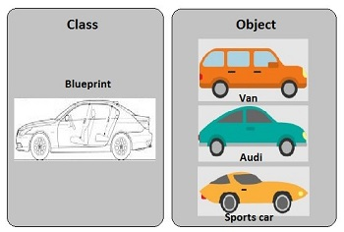

Slide 3
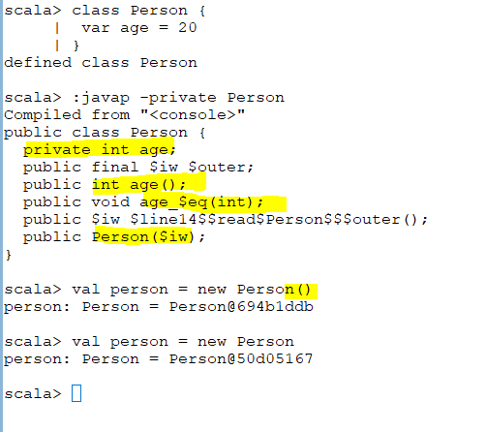
class name
getter
setter
constructor
Object
Notes:
Scala has its own compiler. It compile each code to byte code.
JVM compile one at a time.
Scala automatically generates the setter and getter for “age”
The moment we define var age it will create “ private int age;”
“ public int age();” is a getter (accessor method)
“public void age_$eq(int);” is a setter . _$eq means _equal to
public Person($iw); : constructor of the class
Person (class name) = Person@694b1ddb (Hash code)
Without bracket also works

Slide 4
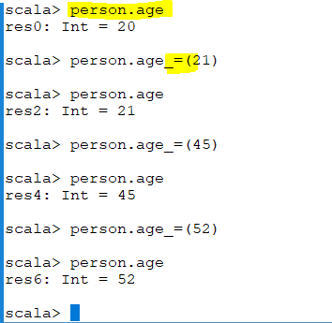
Getter
Setter
Notes:
When we are calling access method we can omit the ()
Scala give us one more privilege

Slide 5
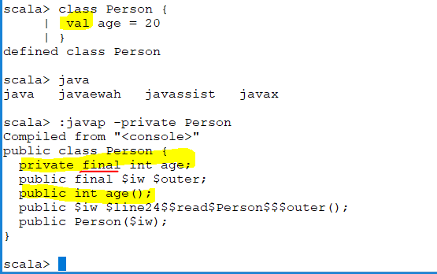
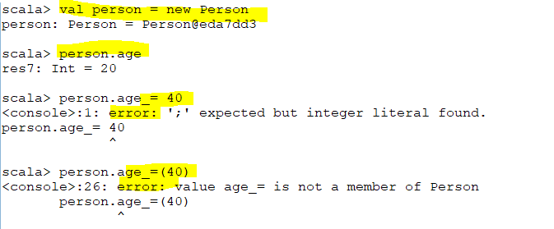
We should not see setter because its val So you will get an error

Slide 6
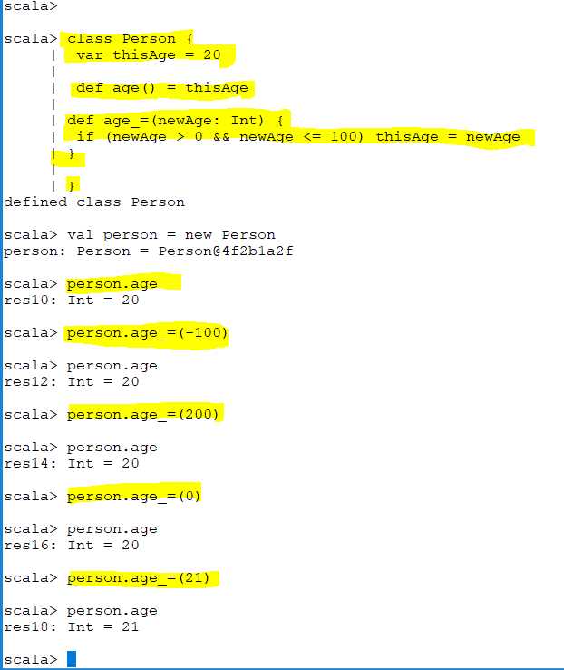
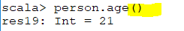
Notes:
Scala says even I give you an option to use getter method
class Person {
var thisAge = 20
def age() = thisAge
def age_=(newAge: Int) {
if (newAge > 0 && newAge <= 100) thisAge = newAge
}
}
def age = thisAge

Slide 7
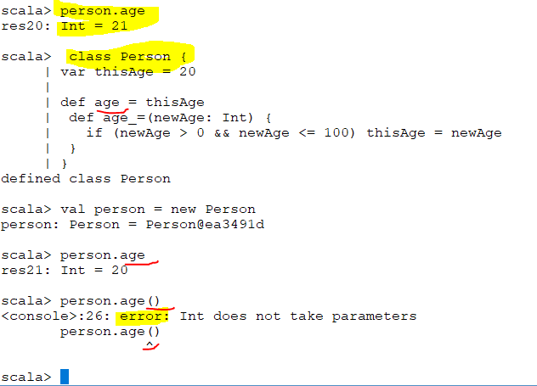
no ( )
no ( )
Scala says even I give you an option to use getter method with () and without () but I can enforce it.
Notes:
class Person { no ( )
| var thisAge = 20
|
| def age = thisAge
| def age_=(newAge: Int) {
| if (newAge > 0 && newAge <= 100) thisAge = newAge
| }
| }
============================

Slide 8
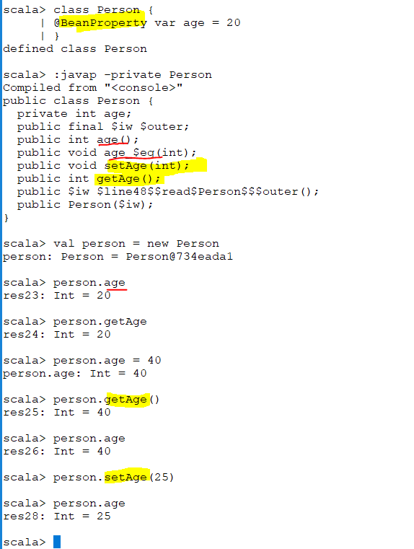
Java time get and setter
Java time get and setter
Notes:
Generate java time get and setter by using @BeansProperty
===========================================
In Java, getter and setter are two conventional methods that are used for retrieving and updating value of a variable. So, a setter is a method that updates value of a variable. And a getter is a method that reads value of a variable. Getter and setter are also known as accessor and mutator in Java.
There are times when you're working with Scala where backwards compatibility with Java and JavaBeans is required.

Slide 9
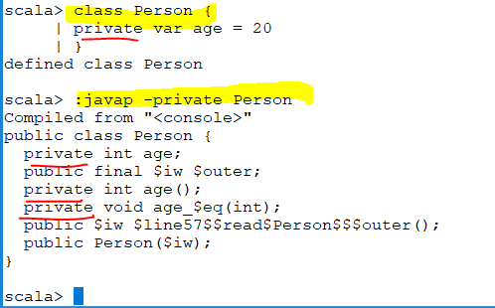

Slide 10
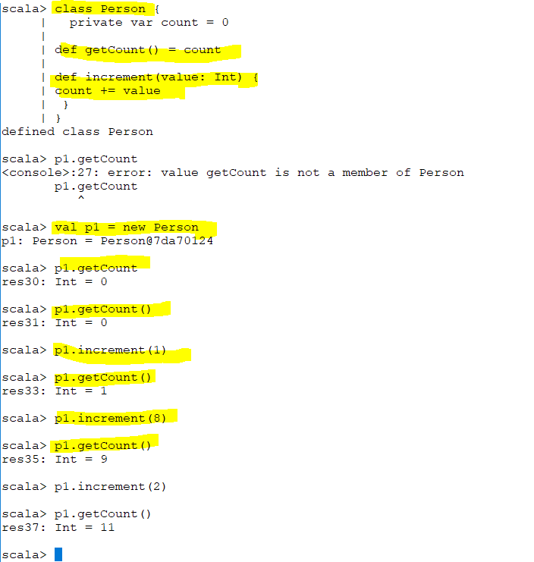

Slide 11
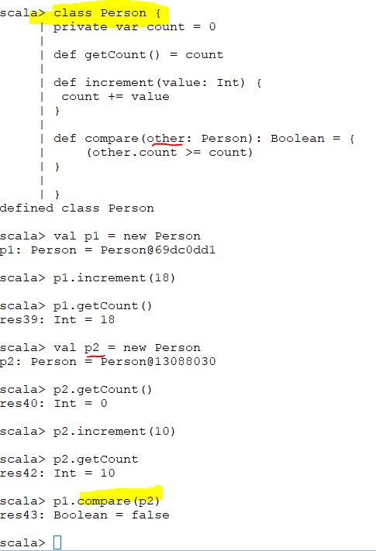
I am referring to other.count
Even if a particular attribute or variable in a class is private instances of the same class can refer to private variable directly because they are part of the class. Only when there is an object of another class then they are not able to refer to
Notes:
class Person {
private var count = 0
def getCount() = count
def increment(value: Int) {
count += value
}
}

Slide 12
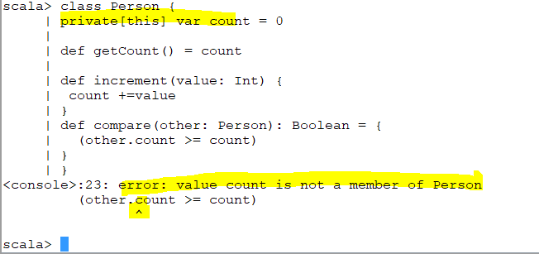
More on Slide 20
“private[this] var count “ means only available in the specific object either same class or different class
Notes:
scala> class Person {
| private[this] var count = 0
|
| def getCount() = count
|
| def increment(value: Int) {
| count +=value
| }
| def compare(other: Person): Boolean = {
| (other.count >= count)
| }
| }
Slide 19

Slide 13
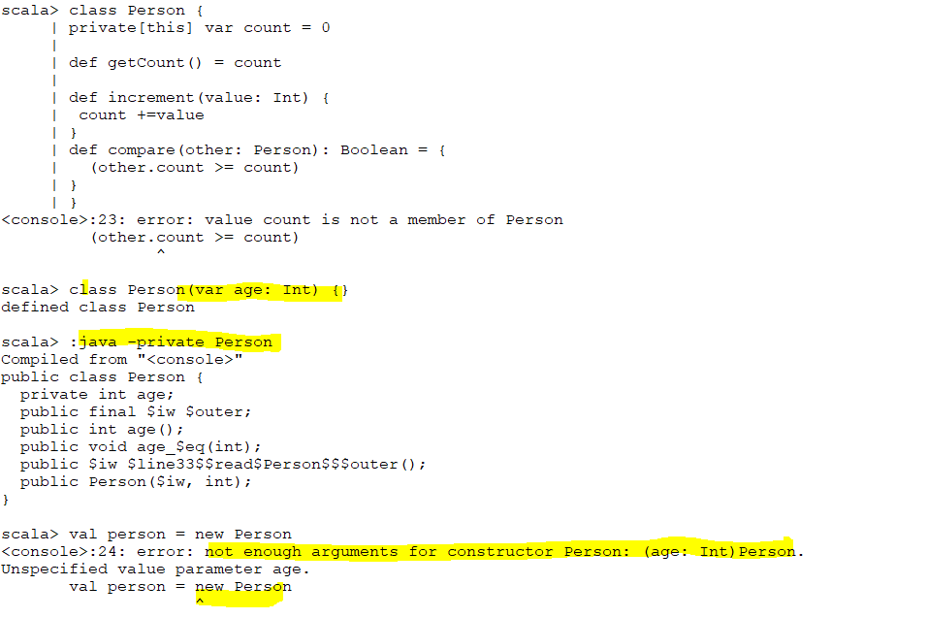
Primary vs Default constructor
We have not defined any constructor so Scala will define the default constructor
Notes:
Whenever I define a variable it will generate each variable to the field of the class .because it’s a field It generates getter and setter as well

Slide 14
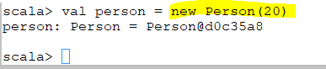
Default constructor /Primary
My defined constructor / Auxiliary
Need to pass a value
Notes:
Default empty primary constructor () :public Person($iw)
Default primary constructor (Top,first screen shot) : I have not defined any primary constructor so it takes the default primary constructor which is public Person($iw)
In the second screen shot I define my primary constructor “class Person(var age: Int) {}” so no longer I can run “val person = new Person” .I need to pass a value “val person = new Person(20)”

Slide 15
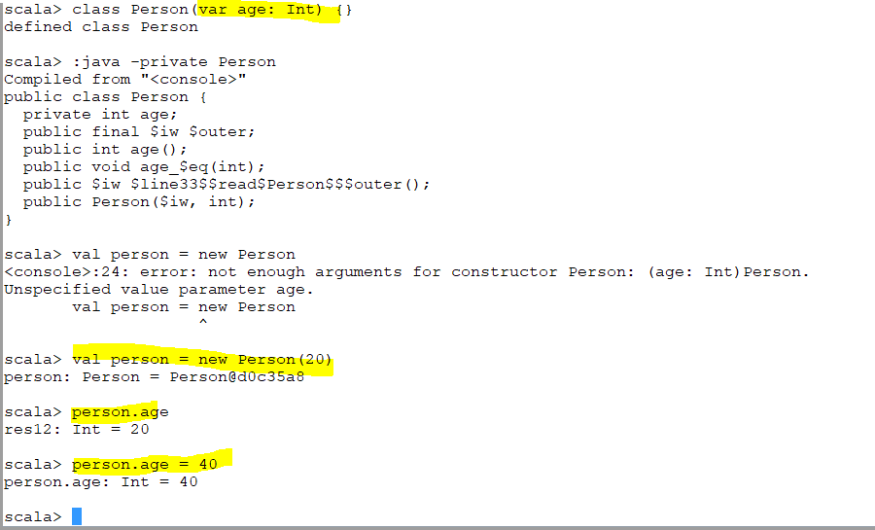

Slide 16
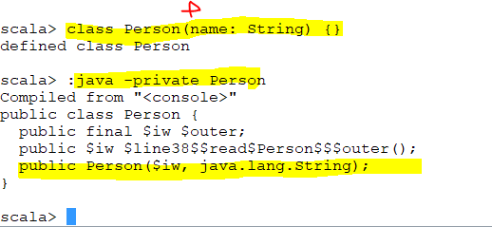
Name is not converted to the field (I just removed var or val from it )
Scala does not generate any variable out of it .so no filed then there is no getter and setter

Slide 17
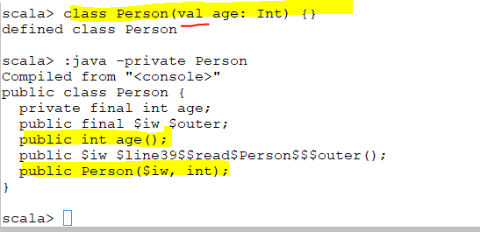
In terms of val it does not generate a setter ,it only generates getter

Slide 18
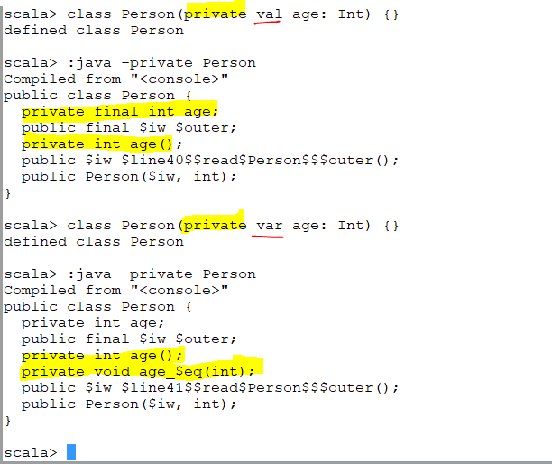
When you define it as private
If it is val it will generates private getter but not setter
If it is var it will generate private getter and setter

Slide 19
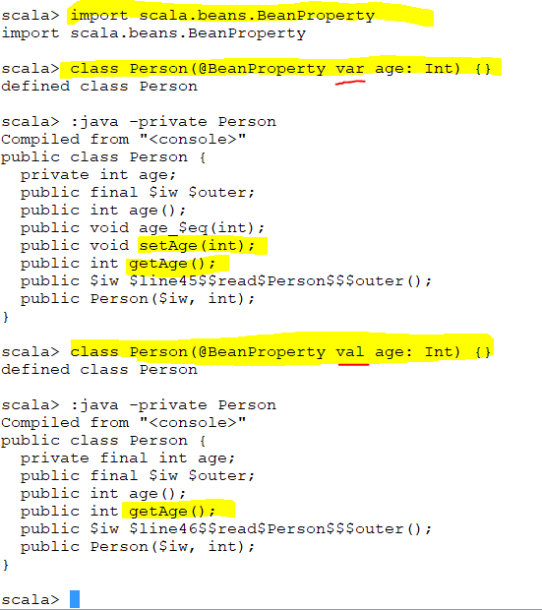
When I use @BeanProperty it will generate java getter and setter for var
And getter javatype for val
Notes:
@BeanProperty is meant for Java interoperability

Slide 20
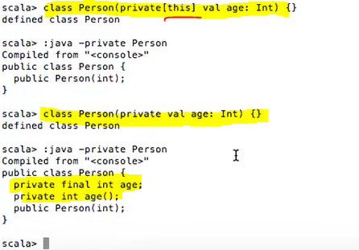
More on Slide 11
When we use private [this] it will be only available with that object that’s why it does not generate getter and setter

Slide 21
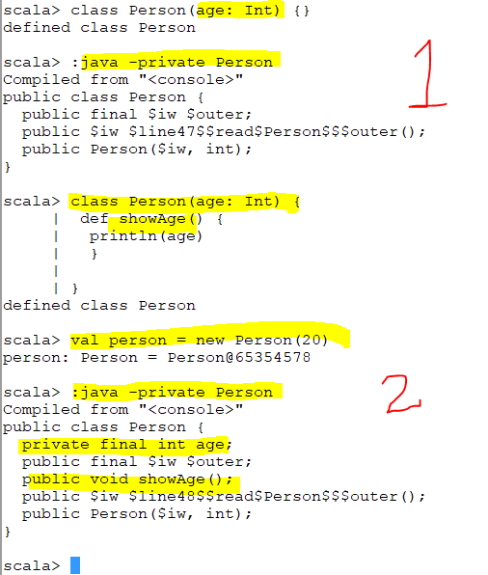
Class Variable
If I am not using var or val for the variable and I am not using that anywhere then that variable can not be a class variable (first screen shot)
Notes:
In both classes I define variable “age” but in the second one I used it within procedure however in the first one I have not used anywhere
In the second one which I used “age” in the procedure the Variable become a class variable
===========================================
private final int age;
public void showAge()
However in the first one variable is no where
public Person($iw, int);

Slide 22
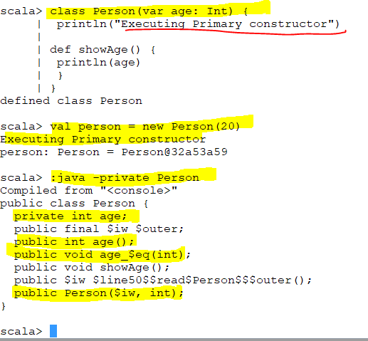
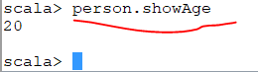
Anything that follows the definition of primary constructor within a class becomes a code which get executed when primary constructor executed.
Notes:
ShowAge is different methods

Slide 23
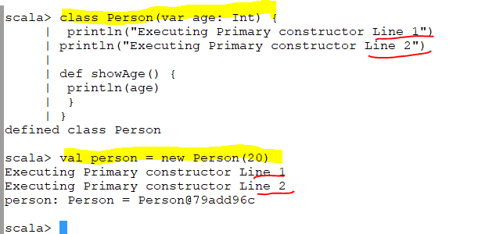

Slide 24
Objects – Singleton Object
An object is an instance of a class
A singleton object is like a static class in Java
The constructor of a singleton object is not executed until the first call to any of the methods of the object is made
An object can have all the features of a class (including inheritance) except constructor parameters

Slide 25
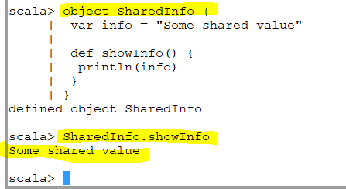
Object
To define a singleton we define object
A class is a template .Out of that class you can generate multiple instance of that
In Scala object you can not generate instance of that
Notes:
What is the different between the object within the class and this object ?

Slide 26
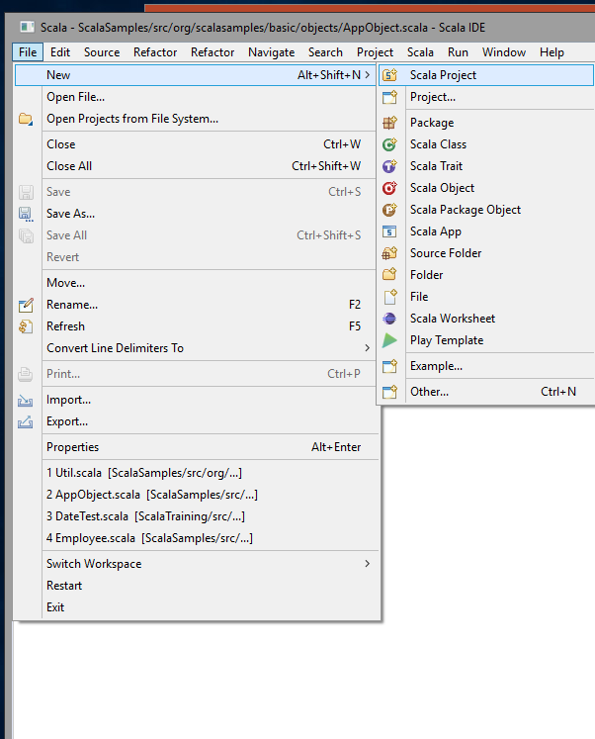
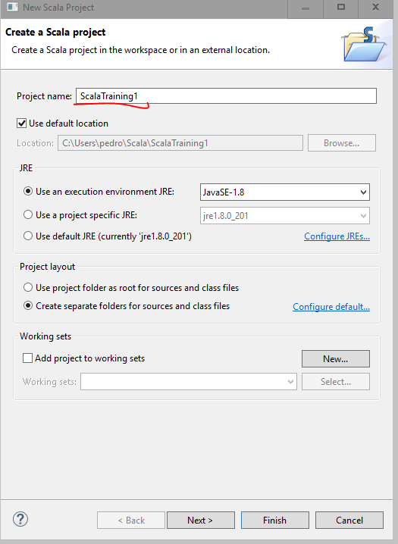
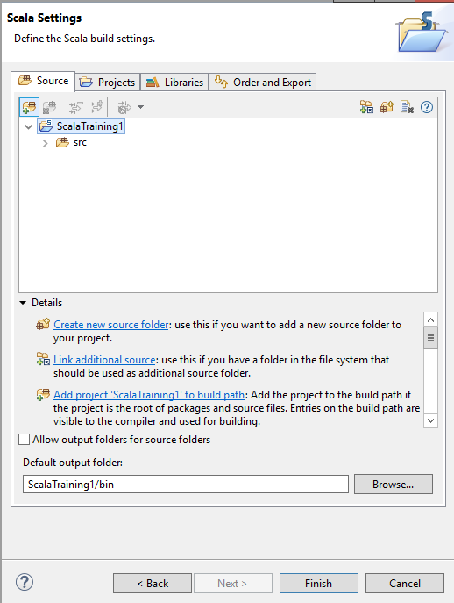

Slide 27
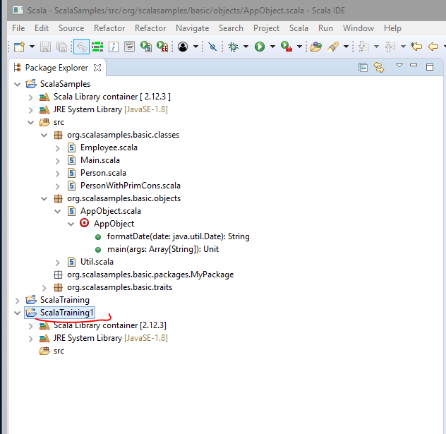
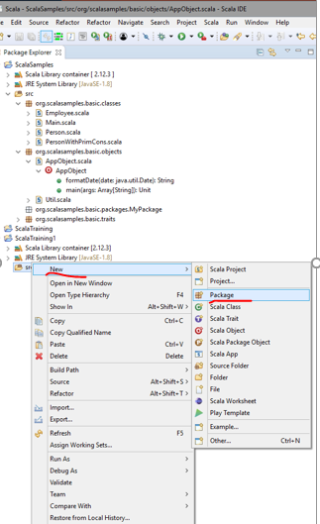
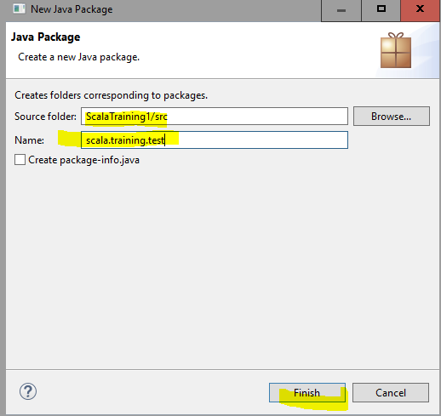

Slide 28
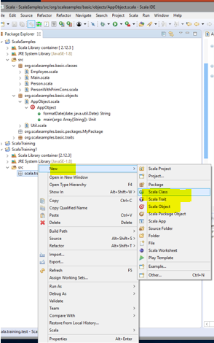
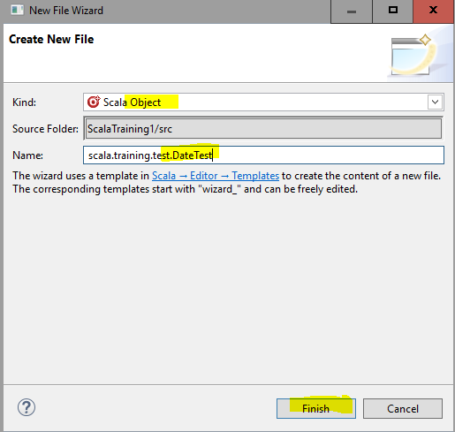
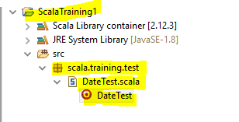

Slide 29
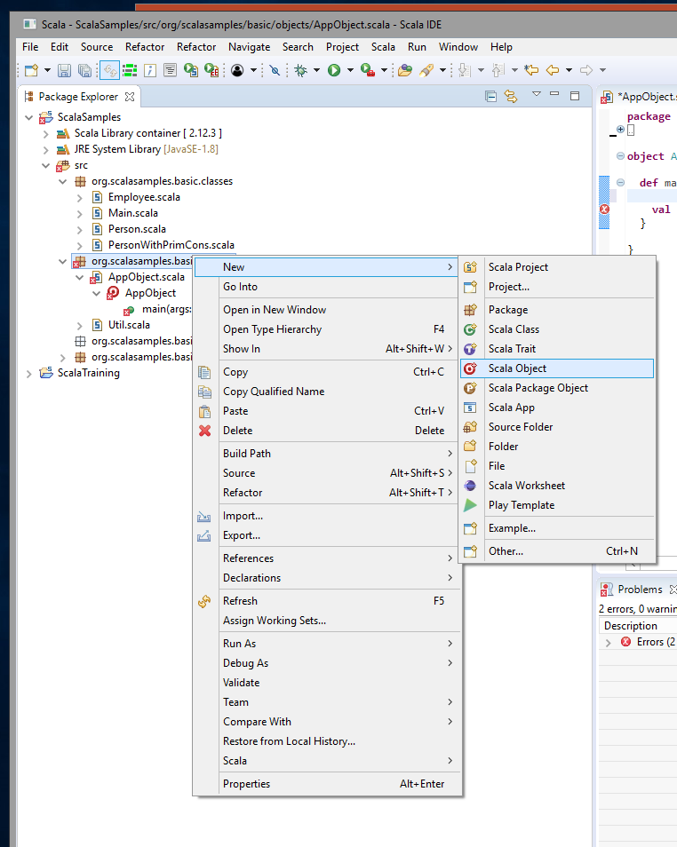
Notes:
Object can be an application object

Slide 30
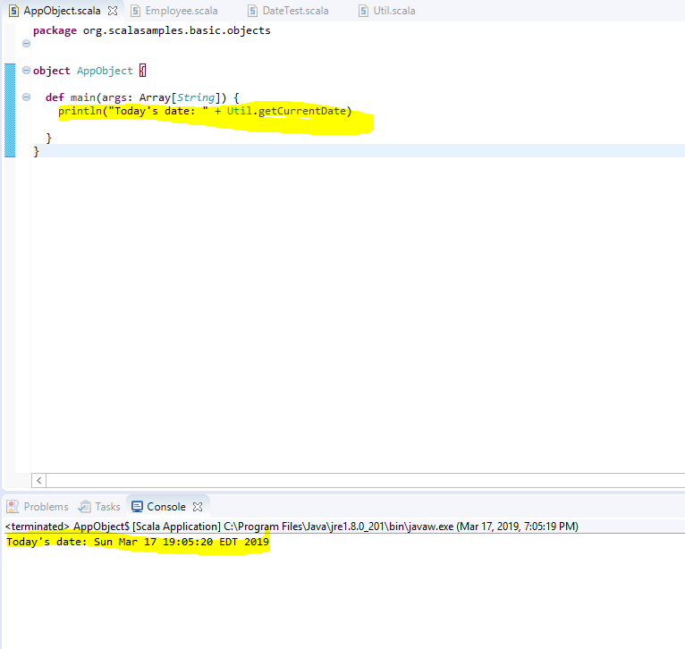


Slide 31
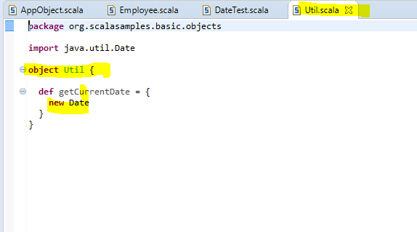

Slide 32
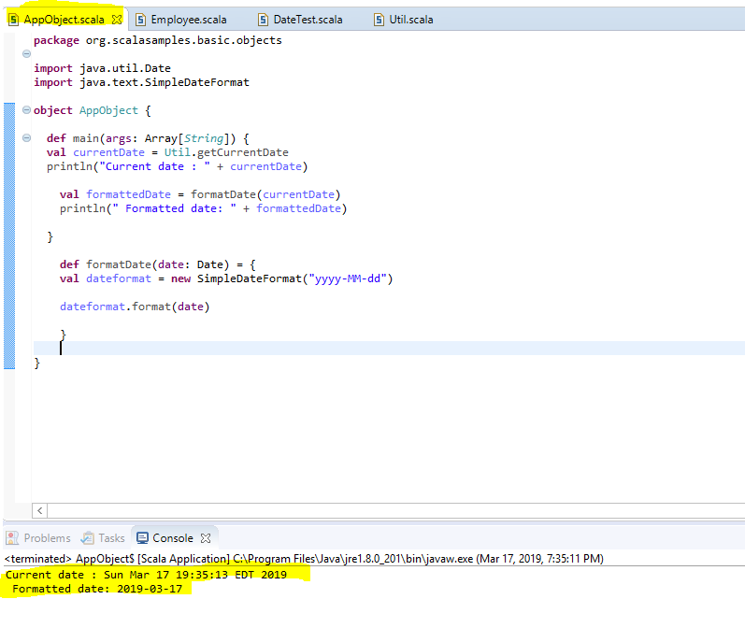

Slide 33
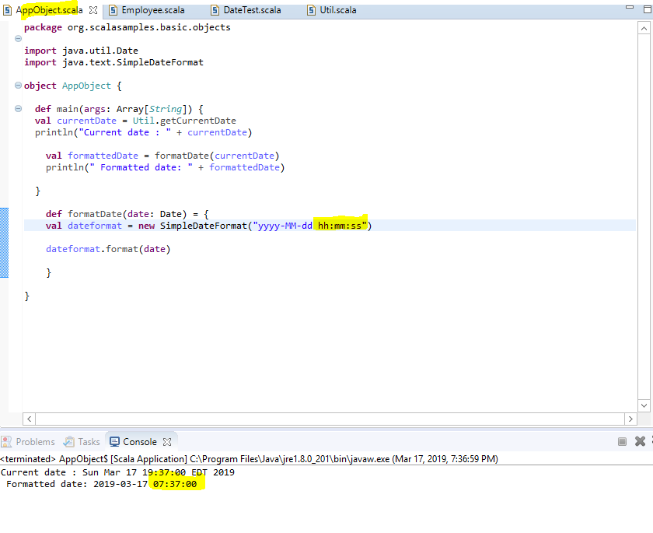

Slide 34
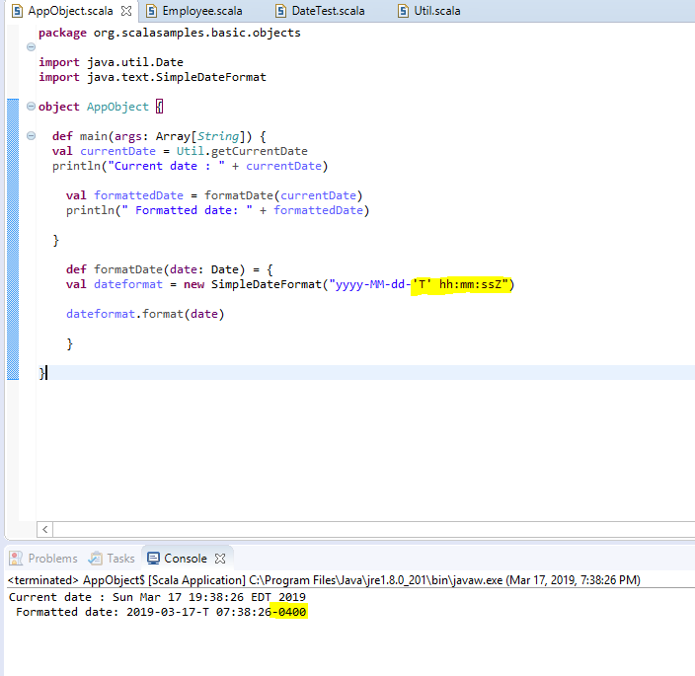

Slide 35
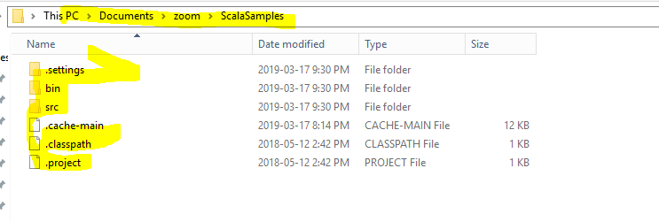
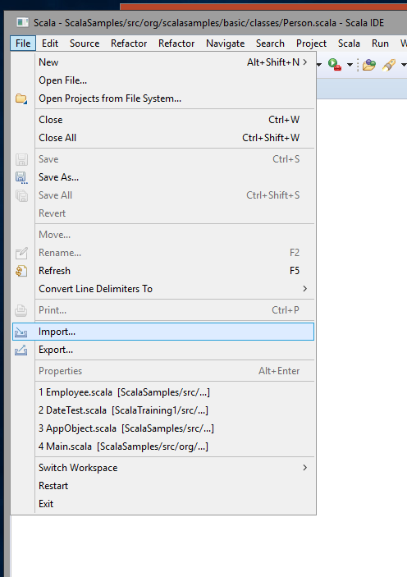


Slide 36
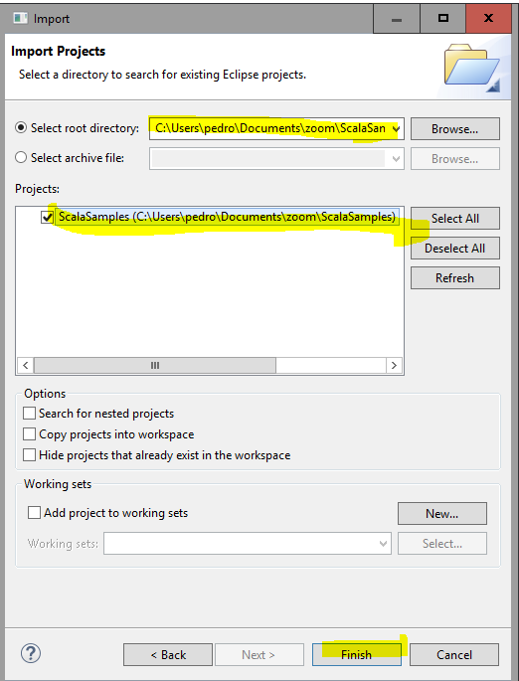

Slide 37
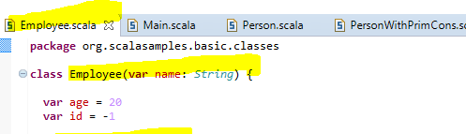
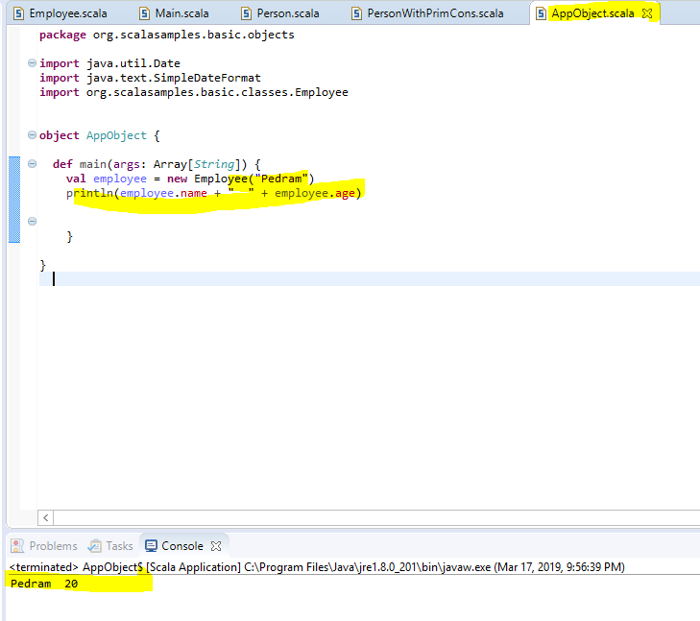
Notes:
Employee (var …) is primary constructor

Slide 38
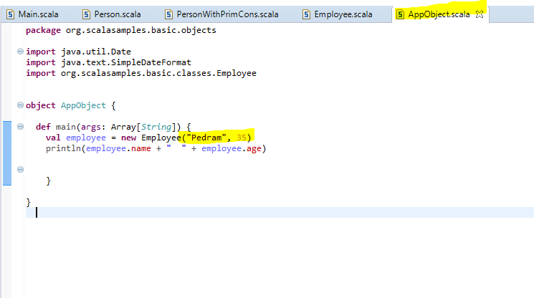
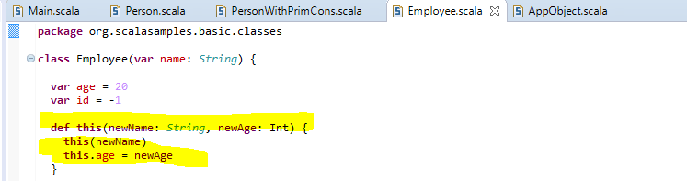
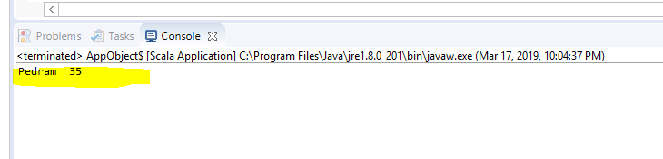
Note :First line in the Auxiliary constructor is a call to the primary constructor
Notes:
Then I pass to the auxiliary constructor (name and age) then age will not be 20 it will be overwritten by newAge
You see how I call it from main object
Note :First line in the Auxilary constructor is a call to the primary constructor
This (newname: String, newAge: Int) is auxiliary constructor
We always call itself (This(newName)
I passed “Pedram” name to Employee class and under Employee class the default age is 20
Auxiliary constructor is a procedure but it calls “this”
The auxiliary constructor in Scala is used for constructor overloading and defined as a method using this name. ... Hence, every auxiliary constructor invokes directly or indirectly to a primary constructor. We can call the primary constructor or other auxiliary constructor using this

Slide 39
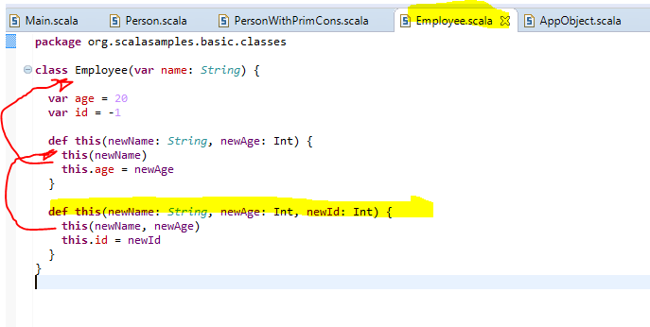


Notes:
The second Auxiliary is pointing to the first auxiliary and the first auxiliary pointing to the primary constructor.
If I do not pass id it will get the default id which is “-1”

Slide 40


Slide 41


Slide 42

We can have only one primary constructor but we can have multiple auxiliary constructor

Slide 43

Objects - Companion
A companion object has the same name as that of the class it accompanies
It is a place for utility methods that belong to the class
Ideally the class should only contain the instance members
A companion object & its class must be located in the same source file

Slide 44


Companion Object
Notes:
Companion Object is a essentially is an object which accompany a class to provide more functionality for that class
It has the same name of that class but it provides its own set up functions
Companion Object provides more functionality for that class
The idea of using of Companion Object is to provide certain utilities on the class which you do not want the object of the class have it but you want to put it in the singleton object and make it available to all classes.

Slide 45


The local variable of auxiliary function
This Variable refer to var age = 0 which is a class variable
Notes:
“age” in def this(age: Int) { refer to the local variable of auxiliary function however “this.age” in this.age = age refer to var age = 0 which is a class variable

Slide 46


Slide 47

Notes:
When we click on c it will give us a class

Slide 48

When click in “o” it will give us “companion object”

Slide 49
Traits
A trait is very similar to an interface in Java 8 or an abstract class in earlier versions of Java
It contains variable & method declarations
Sometimes it may also contain method implementations
It is defined using the trait keyword
A class that extends the trait must implement all the unimplemented methods of the trait
In case it does not, it should be defined as abstract

Slide 50



Traits
Traits like interface in Java Like group of functions
Traits are essentially means to used by classes .a class is extend a trait
I have to implement “isEqual” function otherwise I have to make my class as abstract
Notes:
Traits like interface in Java Like group of functions definition in scala which can basically be implemented in the trait of interface or just the definition of functions
Traits are essentially means to used by classes .a class is extend a trait
In the above example trait “Equals” has two functions one without implementation which is “def isEqual(other: Employee): Boolean” which gets Employee object and returns Bolean and the second one which is “def covertToDouble(n: Int) “ which actually implemented.
Traits are meant to be extended by a class .My class Employee extend the traits call “Equals”
As the class extended the traits so it has to implements all the unimplemented methods of traits or functions of traits .This traits has two functions .The “convertToDouble” has already
implemented so Employee.scala may or may not provide its own implementation. Its up to the class . I have chosen not to provide implementation of “convertToDouble “ function.
I have to implement “isEqual” function otherwise I have to make my class as abstract

Slide 51



If I use abstract then I am not able to instantiate my employee class that makes objects out of it. And if I remove “abstract” then I need to define a function and those error message will be gone.

Slide 52


I have two objects emp1 and emp2 .We are going to print if these two objects are same or not?
So in Employee class there is a function called “isEqual” it will check and see the name and id are equal or not.So if that is the case then main.scala should return a true (Next slide)

Slide 53


Slide 54


Slide 55


Slide 56

I will provide my own implementation
I essentially overrides the method the impimentation which I am using .so I have to specify “OVERRIDE” KEYWORD
If the number is not between o and 100 I return zero and print “Invalid number “

Slide 57


Slide 58


Slide 59

Packages
Packages :You group your classes and entities together in packages
Notes:
Scala allows your packages to contains traits, objects ,classes and functionality
Packages :When you have a category of files you keep them in the single packages.Packages is a directory but can be a single file for example package.scala
Up to 40 (scala 4)

Slide 60

How do I use packages ? I will import by using “_”

Slide 61

Higher order function
() means unit . () : this is a function which takes unit and returns a double.(calculatePI takes a unit and returns double)
“ ( ) => Double = <function0>”
A higher-order function takes other functions as a parameter or returns a function as a result.
Notes:
Calc and x are both variable but calc is pointed to a function.calc holds a function .
Look at the type of variable is “ ( ) => Double = <function0>” () means unit . () : this is a function which takes unit and returns a double.(calculatePI takes a unit and returns double)

Slide 62



_ means current value in another word
Foreach is higher order function
Notes:
_ means current value in another word. it is basically designate the current element variable .Foreach is higher order function which accept another function
Function is supposed to take a variable but here foreach which is a function is taking another function (That how scala works)
Foreach is a function of arr class.
Instead of addSalutation we could have done :” sayHello”

Slide 63

Map is another higher order function
Map returns a value .It passes the current element (2 in the first case, 50 in the second case , 28 in the third case and 36 in the forth case ) to double .

Slide 64


Slide 65


Slide 66

Notes:
Variable operation

Slide 67


Slide 68


Slide 69


Slide 70


Slide 71


Slide 72


Slide 73

Anonymous Functions (or inline function)
Functions will have
Anonymous Functions will return
Anonymous Functions (or inline function) Does not have a name
Notes:
Left hand side of “(x: Int) => (x * 2)” ;List of variable which this Anonymous Functions will have (x: Int) => (x * 2)
RHS :(x * 2)” : is the body which this Anonymous Functions will return

Slide 74


Slide 75


Slide 76

We can also summarize more .

